Slide 1
UniProgrammes
Project plan and vision

Slide 2
Project Overview
Context :
University programs can be quite tough to navigate and finding
all the information you need about the courses you want to take
can be quite tricky.
Goal of this project :
Develop a user-friendly interface that would automatically collect
the data about courses on the website to make it easier to navigate
and get information about the requirements of any course.

Slide 3
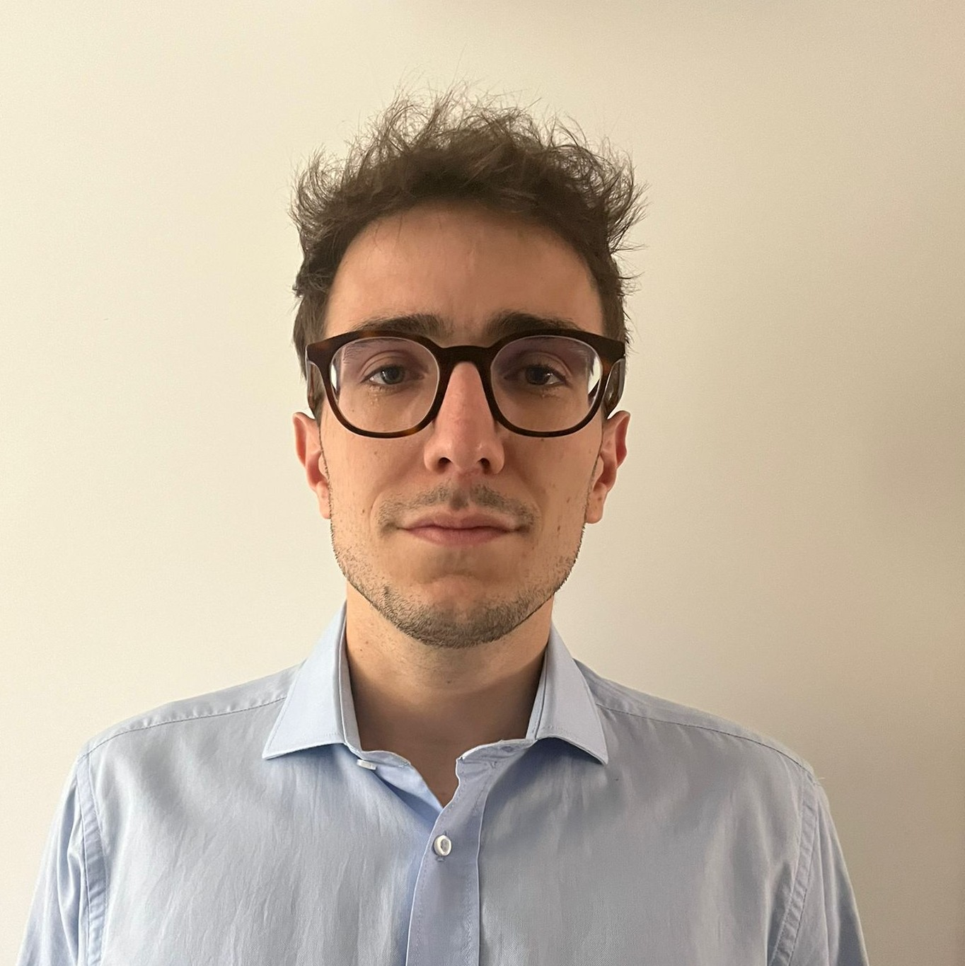





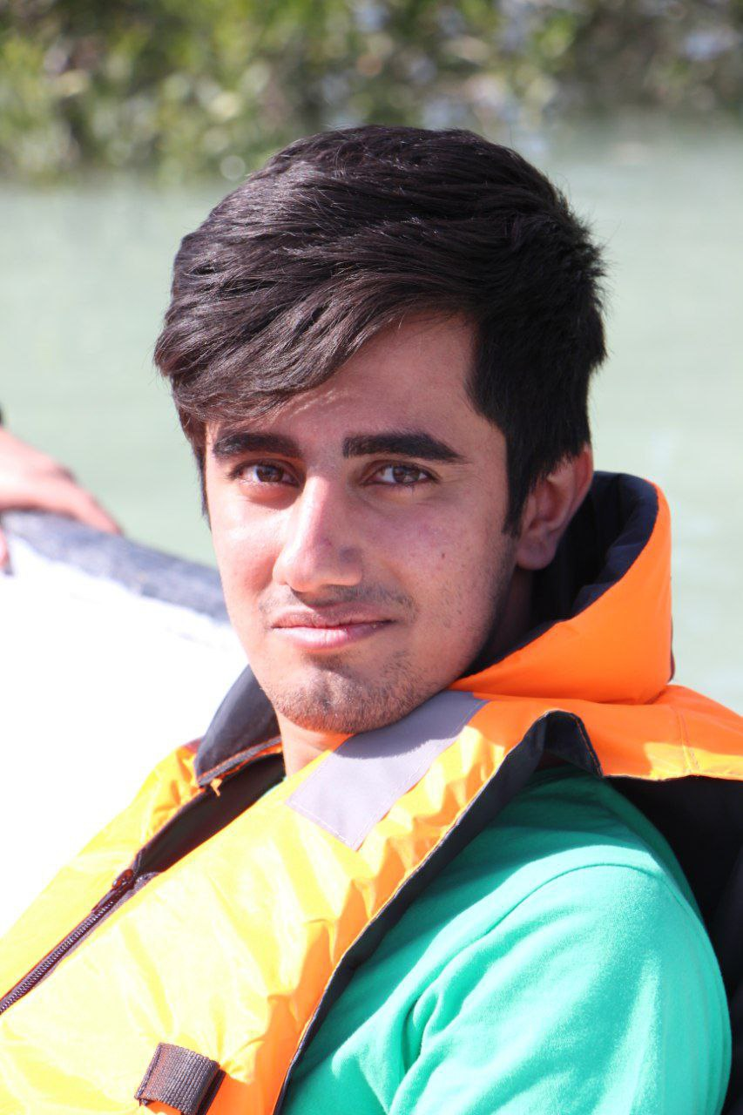

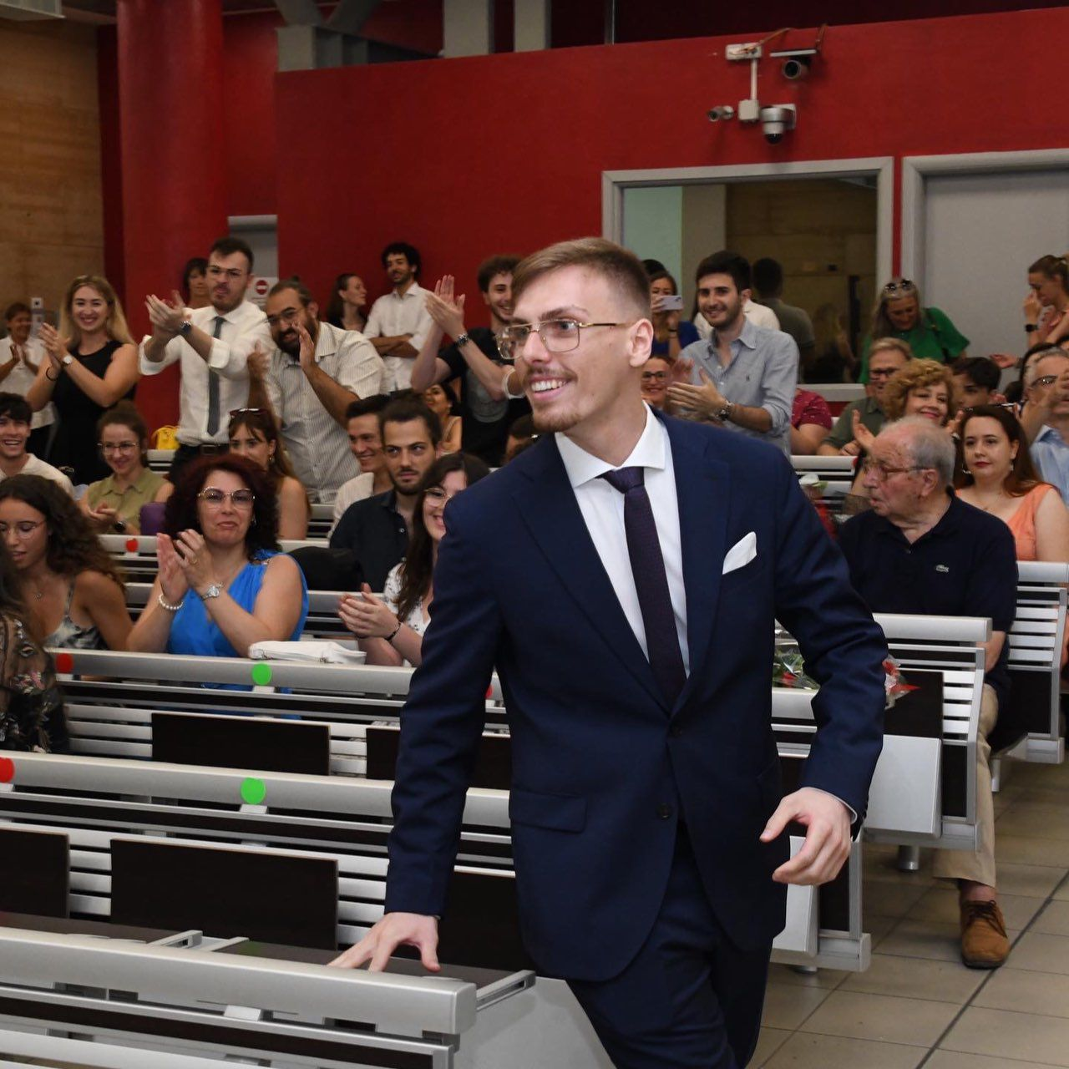
Our team
A
Andrea Cataluffi
Carlos Gálvez
Satvik Sharma
Maša Pejović
Clara Despres
José Miguel Quintana
Ali Hajizadeh Idloo
Pilar Bocage
Giuseppe Vitello

Slide 4
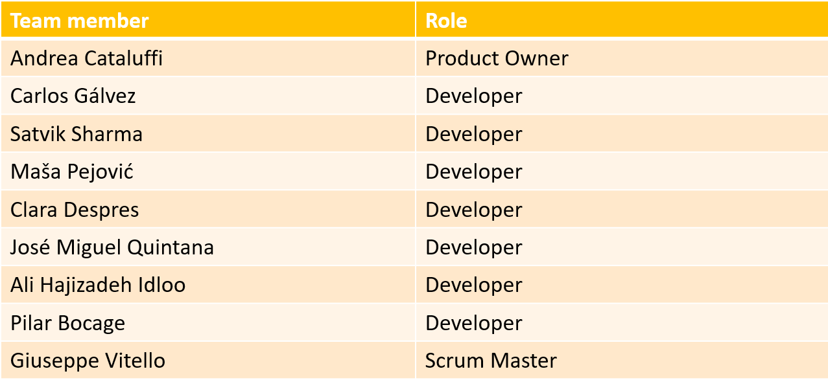
Team Organization

Slide 5
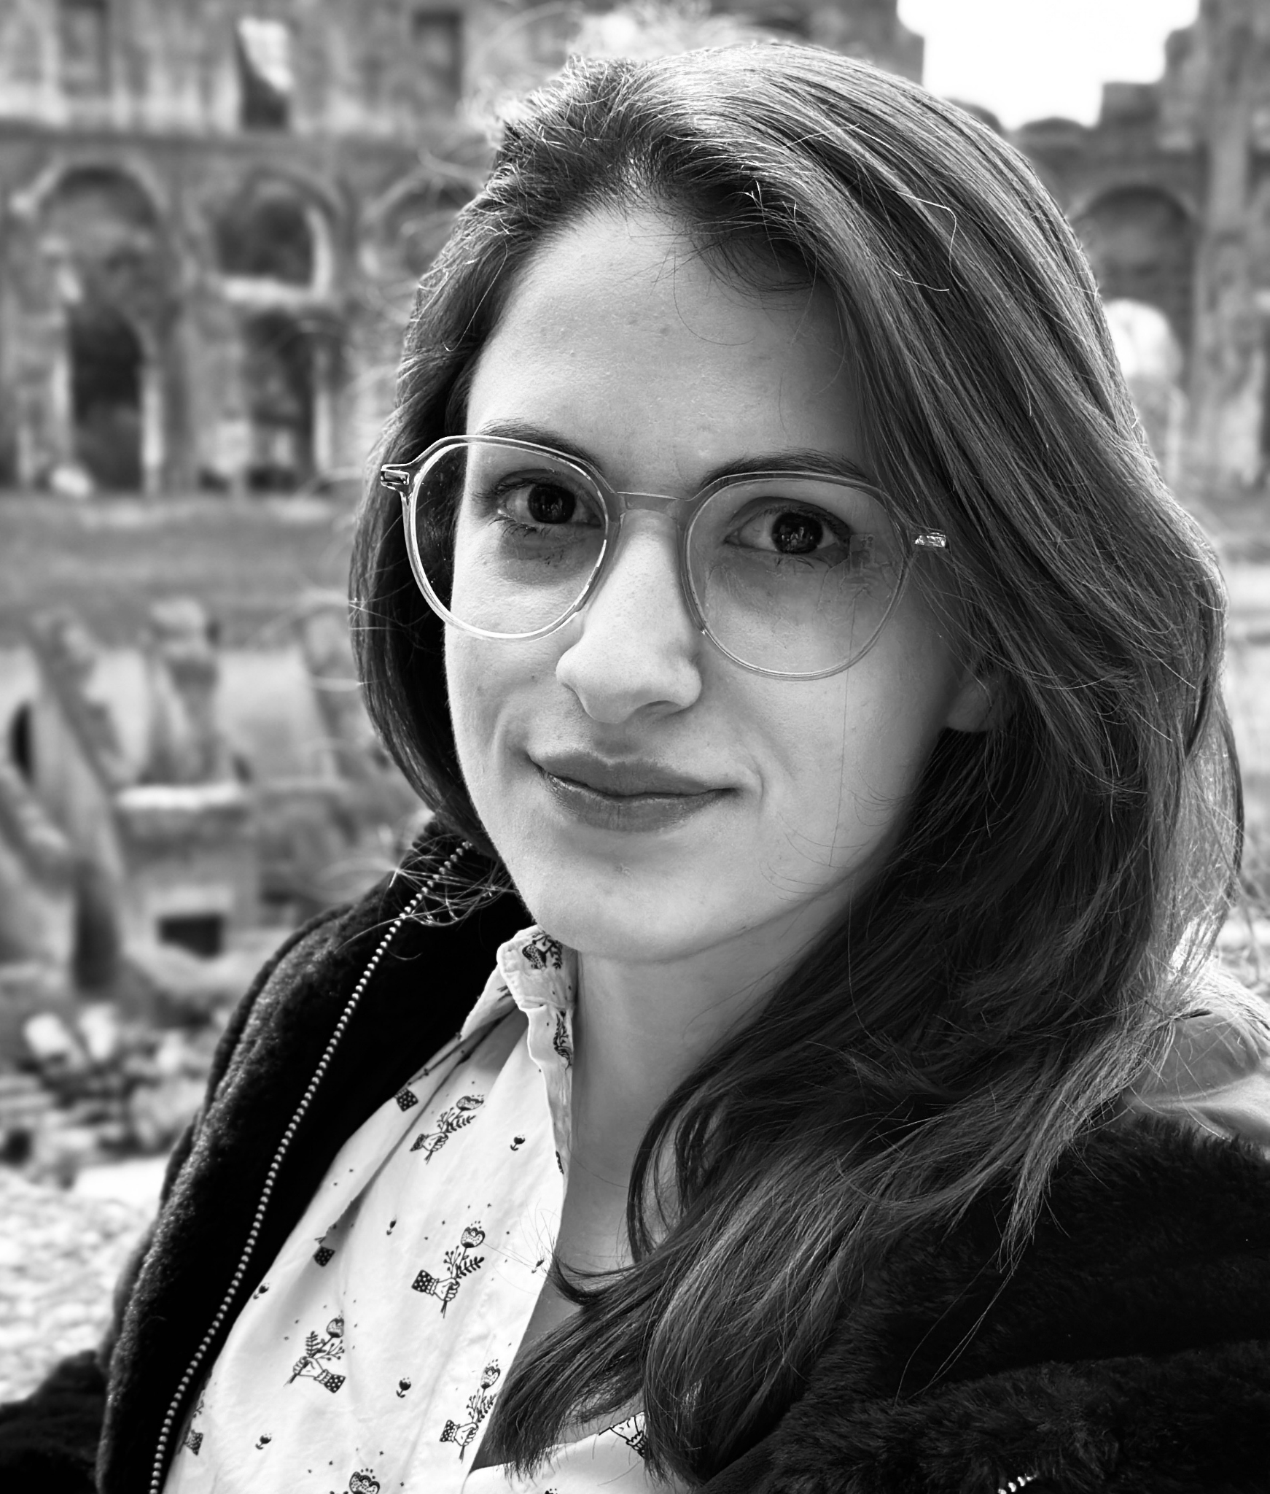

Project Supervisors
Enxhi Ferko (MDU)
Giovanni Quattrocchi (POLIMI)

Slide 6
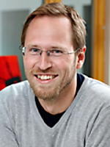

Project Customers
Fredrik Ekstrand (MDU)
Jonatan Tidare (MDU)

Slide 7




Tools
Communication
Management
Repository

Slide 8

High-Level Overview of the Requirements

Slide 9
Core Functionality & User Interface
Data Collection & Analysis
Graphical Representation
Automatic collection of course/programme info
Extract course attributes: credits, requirements, learning outcomes, schedule
Categorize and analyze learning outcomes
Filter by categories (e.g., group work, report writing)
Check for schedule conflicts and requirement validity
Visualize programme structure with tree view
Display prerequisites, course progression, and links
Enable drag-and-drop course management
Highlight issues in course requirements post-reorganization

Slide 10
Technical & Non-Functional Requirements
Data Processing & Validation:
User Experience & Scalability:
Algorithms for learning outcome categorization
Validate course requirements and credit allocation
Check group work progression and consistency
Intuitive, user-friendly interface with drag-and-drop
Fast response time and rendering of large programme trees
Modular, scalable design for easy updates
User access control and version tracking

Slide 11
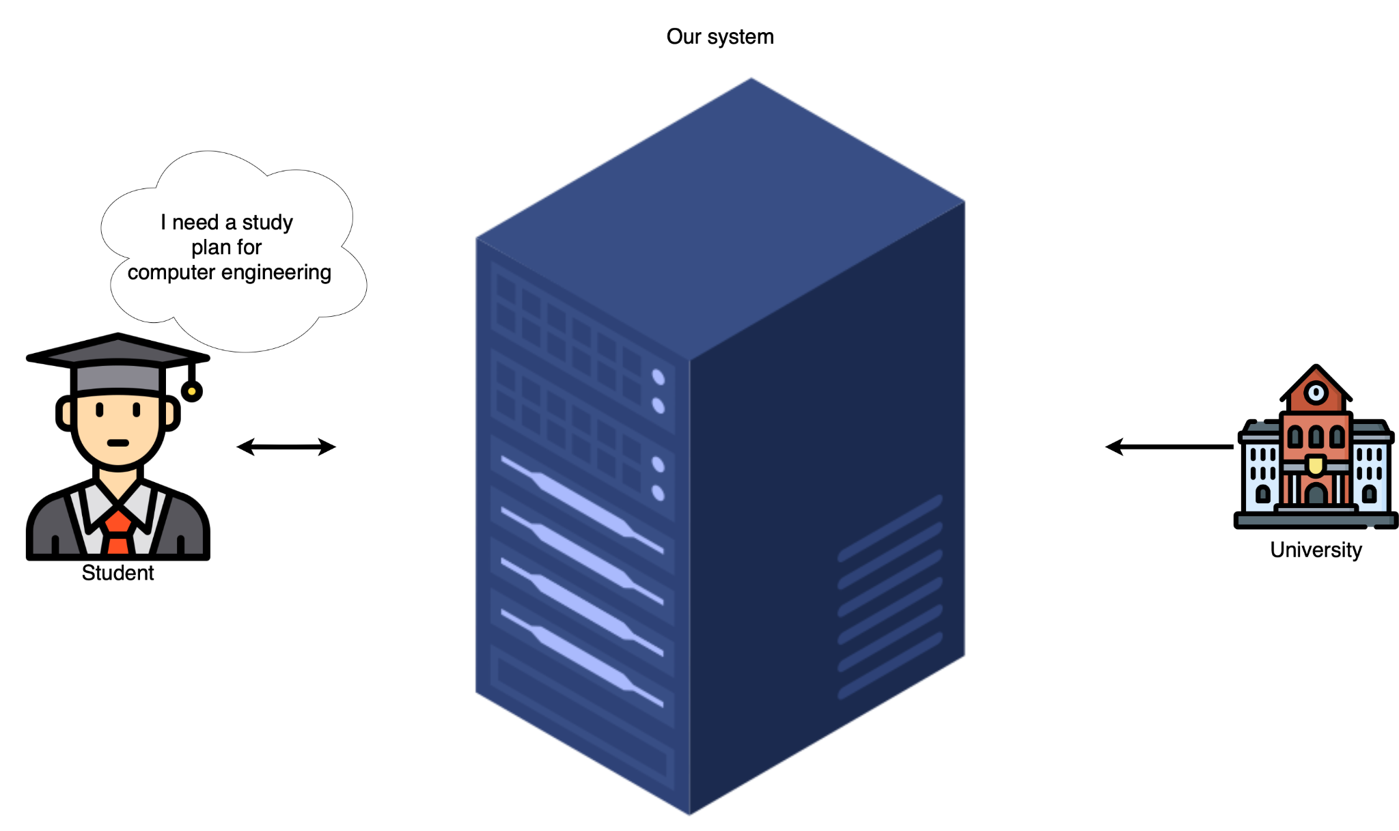
High level of the solution

Slide 12
Risk Assessment Analysis
Three environments (Dev, QA, Prod) minimize production issues by catching errors early.
Continuous Integration (CI) reduces risk of code inconsistencies and type errors.
Pull Request Approval Process ensures code quality through mandatory peer review.
Unit + E2E Testing unit prevents bugs and regressions by validating functionality in each update, E2E allow testing the user interaction.
Team member turnover during the project poses a risk to continuity and progress.
Uneven team commitment throughout the development process may affect project timelines and quality.

Slide 13
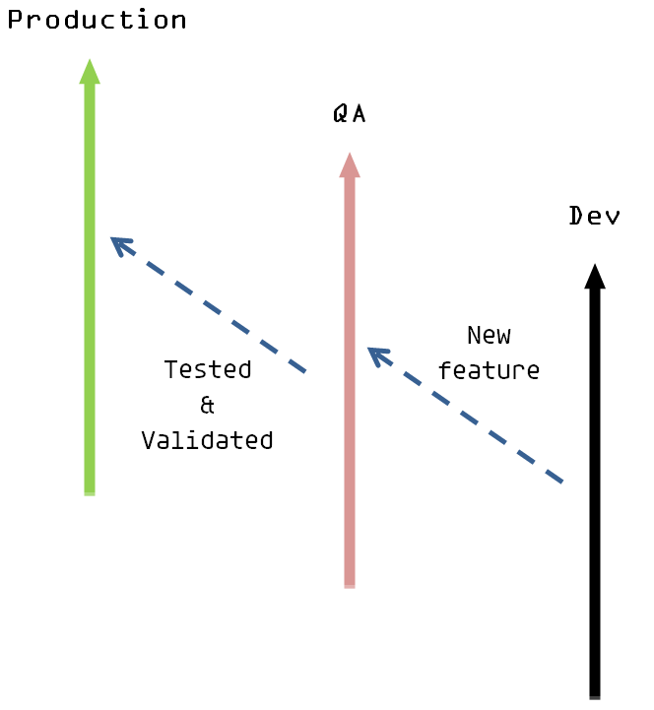
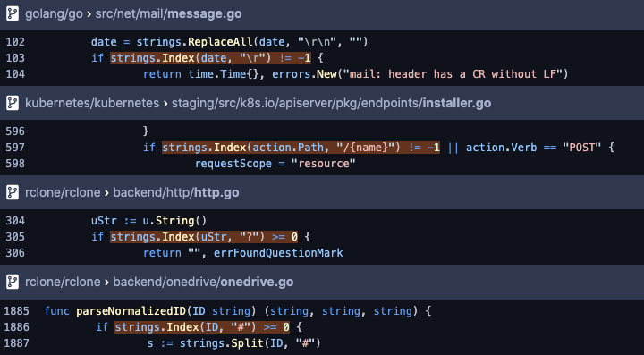
Quality Assurance Procedures
Three environments
Dev: ongoing development
QA: testing features
Production: stable release
CI
Format style and data types checks on every pull request

Slide 14






Quality Assurance Procedures
Pull Request Approval Process
In order to merge a new feature, at least one approval apart from the developer will be required.
Unit/E2E Testing
Ensuring that new features doesn’t introduce bugs in the code.

Slide 15






Technologies (consideration)
Framework
Data retrieving
Database

Slide 16
Not Addressing
Student enrollment management
Financial aspects of programme planning
Curriculum content creation
Student performance tracking or grading systems
Integration with external accreditation bodies
Direct modifications to university websites or databases

Slide 17
Sprint 0 Report
We had 3 meetings :
Meeting the team
With one of the supervisors to meet them, discuss the beginning the project and share the platforms we decided to use
With the team to divide up the work for the sprint
As a team, we discussed:
Our vision of the project
The rules to ensure a good progress
The different roles in the team
The technologies chosen to implement

Slide 18
Sprint 0 Report
Difficulties experienced during this first week :
Finding the best time to meet (with supervisors and the team)
Finding the most practical communication channel
Deciding the role distribution
Setting up a meeting with the supervisors

Slide 19
Time spent by every member
Team Member | Hours spent on Sprint 0
Andrea Cataluffi | 5
Carlos Gálvez | 4.5
Giuseppe Vitello | 1
Satvik Sharma | 5
Maša Pejović | 4.5
Clara Despres | 4.5
José Miguel Quintana | 4.5
Ali Hajizadeh Idloo | 5
Pilar Bocage | 2

Slide 20
Any question ?

